Slide 1

https://www.nytimes.com/2019/05/22/magazine/soccer-data-liverpool.html

Slide 2
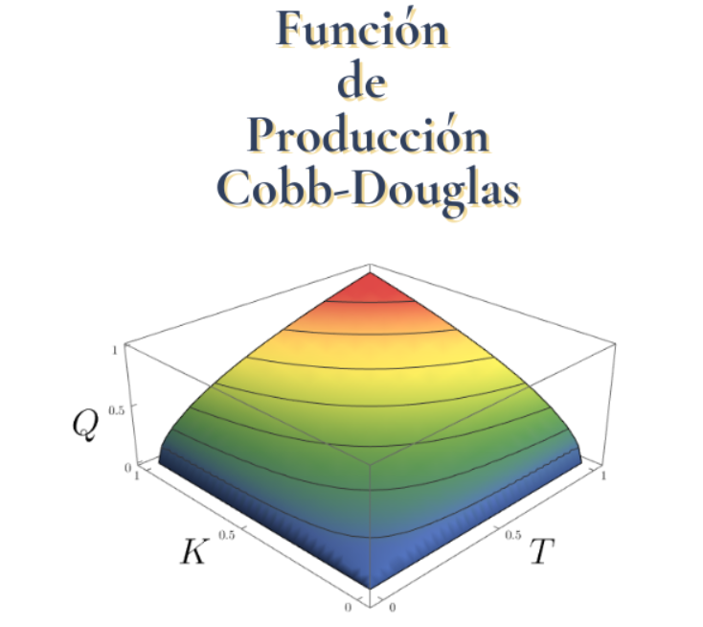

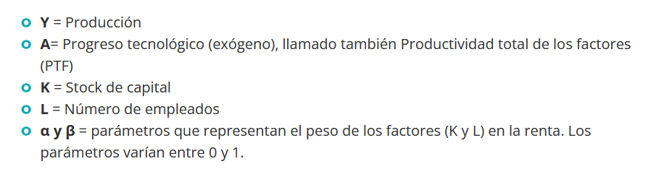
https://economipedia.com/definiciones/funcion-de-produccion-cobb-douglas.html

Slide 3
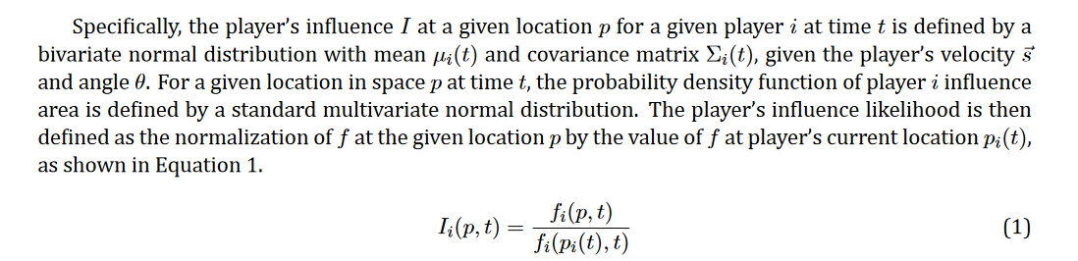
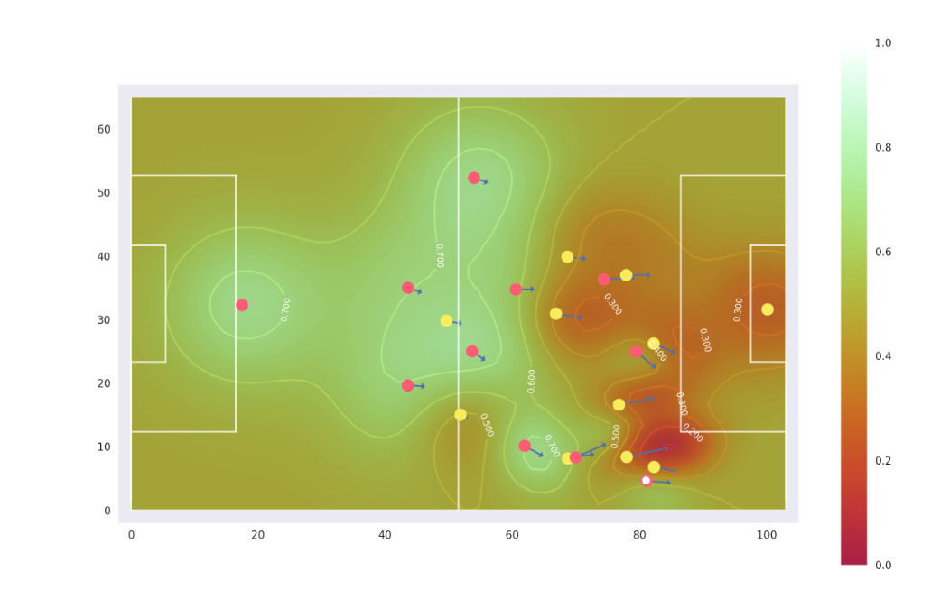
http://www.lukebornn.com/papers/fernandez_ssac_2018.pdf

Slide 4
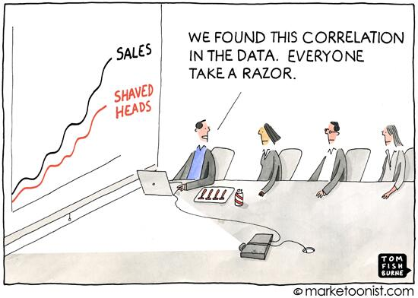

Slide 5
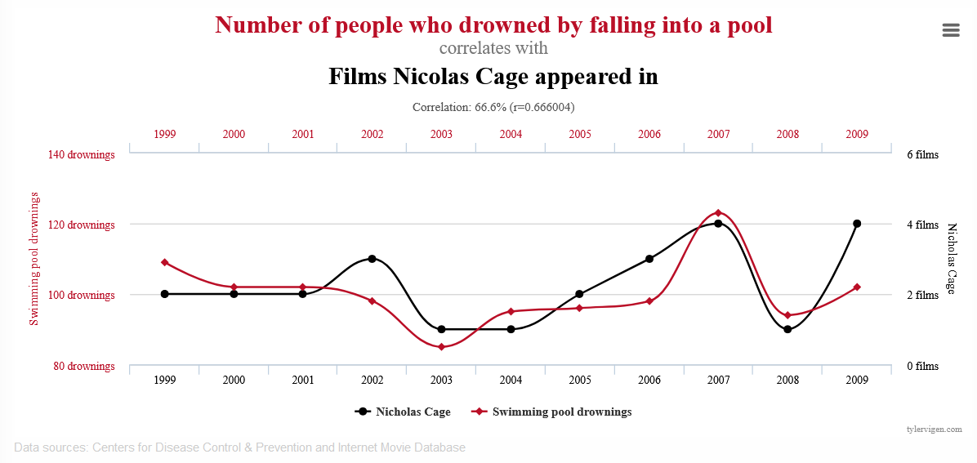

Slide 6
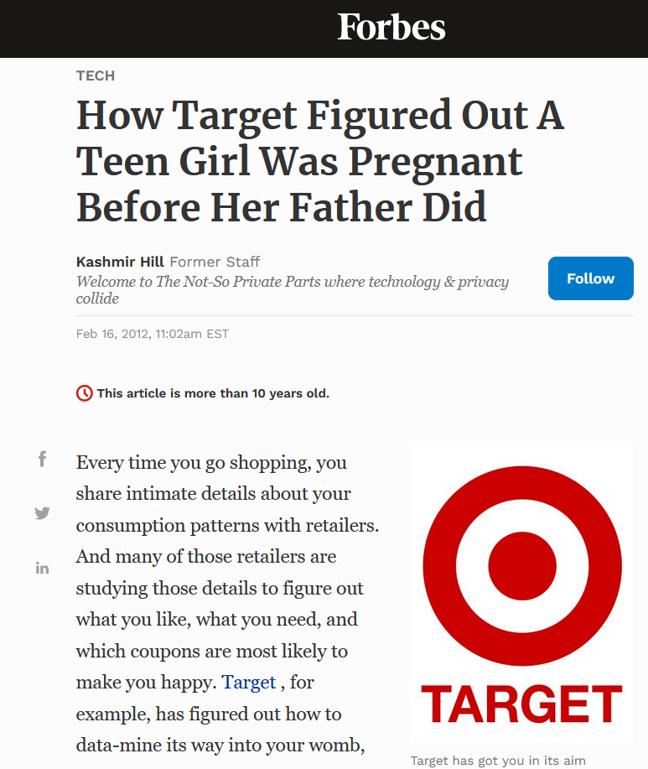
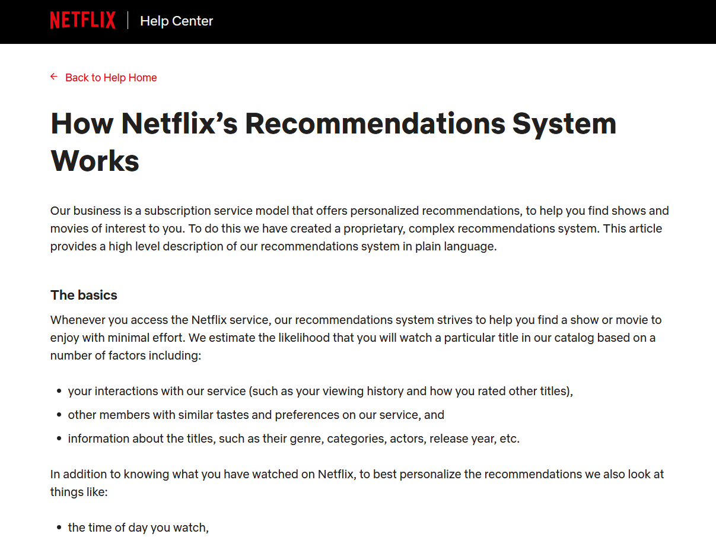
https://help.netflix.com/en/node/100639
https://www.forbes.com/sites/kashmirhill/2012/02/16/how-target-figured-out-a-teen-girl-was-pregnant-before-her-father-did/?sh=11920e676668

Slide 7
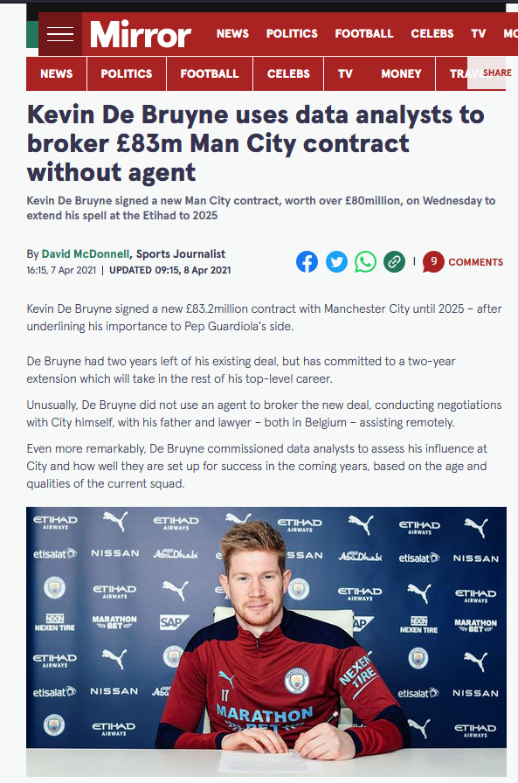
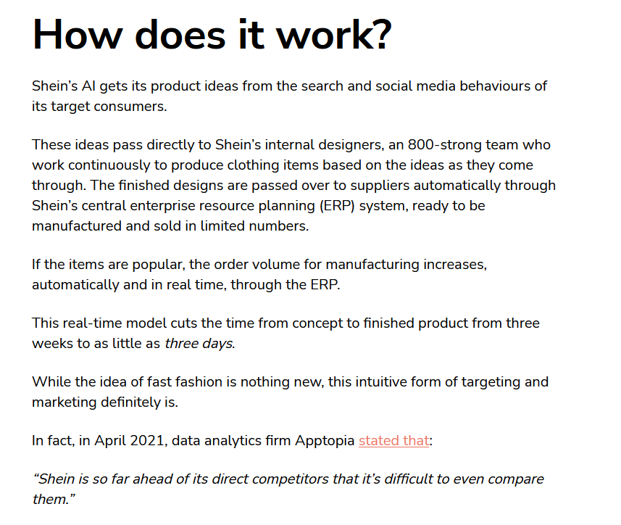

https://norna.ai/news/?p=378
https://www.mirror.co.uk/sport/football/news/kevin-de-bruyne-uses-data-23870686

